Slide 2
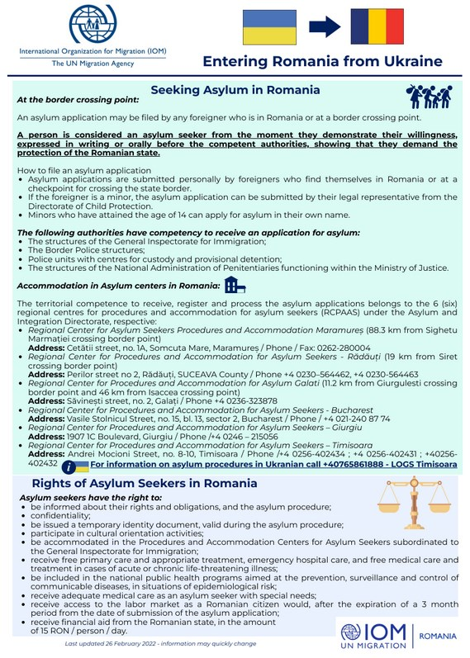
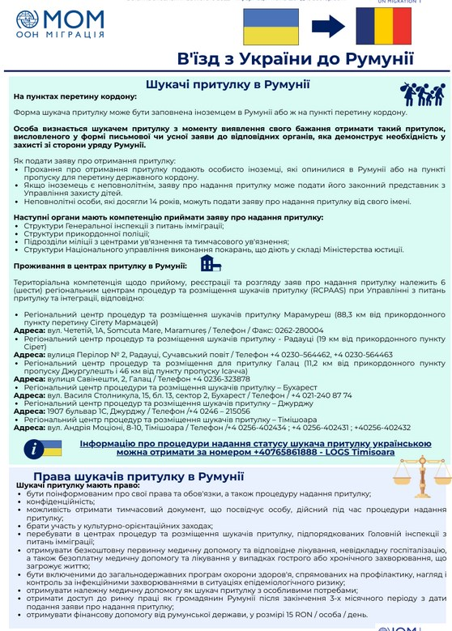
Romania: the online support platform dopomoha.ro (developed by Code4Romania with support from IOM Romania) is now live here
https://dopomoha.ro/en
https://romania.iom.int/news/useful-information-people-entering-romania-ukraine

Slide 3
TRUSTED DONATIONS
https://www.justgiving.com/crowdfunding/plushiehelpnetwork
https://www.gofundme.com/f/plushieaid-for-peace?qid=47497a6161281db259de7cef6faf3719
https://www.instagram.com/plushieauction4ukraine/
https://www.aktion-deutschland-hilft.de/
https://entwicklung-hilft.de/
https://www.spendenkonto-nothilfe.de/
https://www.drk.de/
https://www.care.de/
https://www.care-international.org/
https://www.aktiongegendenhunger.de/
https://www.uno-fluechtlingshilfe.de/
https://www.theconqueror.events/de/stand-with-ukraine/

Slide 4
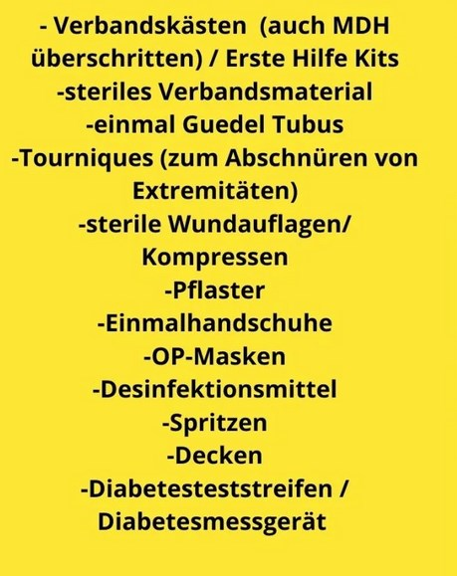
Sachspenden /Donations in kind Germany
https://www.instagram.com/opa_whoopi/

Slide 5
TRAVEL INFORMATION
IOM Hotlines for Persons Affected by the Crisis in Ukraine
And other useful informations:
Ukraine: 527 (free from mobile phones),
0800505501 (free from landline phones)
Slovakia: from abroad 00421 5263 0023,
locally 0850 211 478,
Telegram/Signal: 00421 908 767 853 (voice only)
https://www.mic.iom.sk/en/
Lithuania: +370 525 14352 is run by IOM's Migration Information Centre, also available through live chat on this website
https://www.renkuosilietuva.lt/ru/
https://www.gov.pl/web/ua
IOM Hotline
Poland: +48 22 490 20 44
https://www.bamf.de/DE/Themen/AsylFluechtlingsschutz/ResettlementRelocation/InformationenEinreiseUkraine/informationen-einreise-ukraine-node.html

